Slide 2
01
02
03
INTRODUCTION
OVERVIEW
SCOPE OF SERVICES
04
05
06
SCOPE OF
WORK
ALTERNATES
SCHEDULE

Slide 3
INTRODUCTION

Slide 4
PRESENTERS
BRAD BECKERT, P.E., P.S.
Assistant Commissioner of Development
CLEVELAND AIRPORT (CLE)
MICHAEL CARROLL, P.E.
TMDP Implementation Manager
PASLAY GROUP

Slide 5
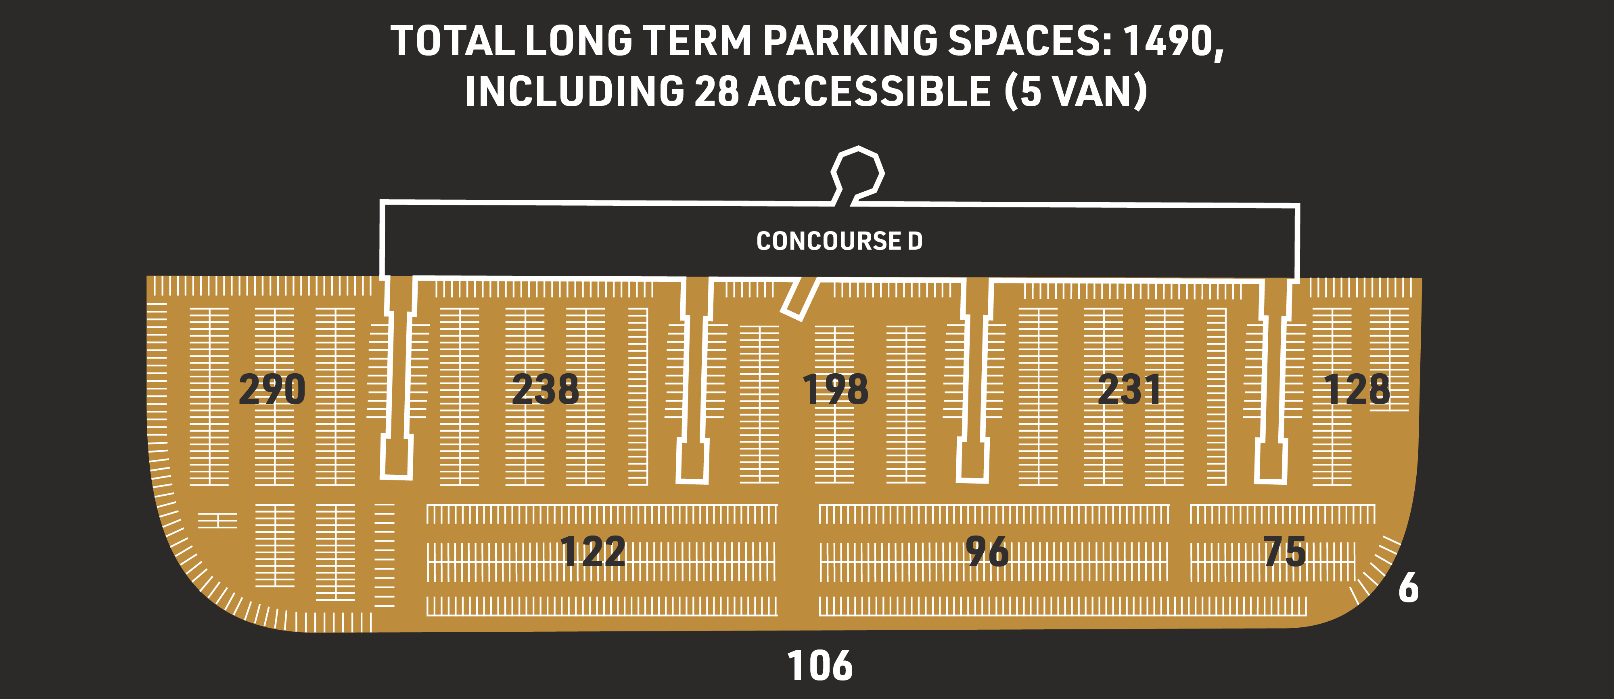
GOLD LOT - PROJECT OVERVIEW (PRE-SCHEMATIC)

Slide 6
OVERVIEW

Slide 7
GOLD LOT: PROJECT OVERVIEW
  This is a Design & Build Project
  Firms will respond to the RFQ and the successful Firm will negotiate with Airport
  Take direction from, and report to, Project PM/CM
  Manage Project through Airport provided PROCORE Project
  Management software platform

Slide 8
GOLD LOT: PROJECT OVERVIEW
  Past parking lot design and construction experience to be included in response to RFQ
  Past aviation experience and experience working with FAA on projects (7460 permit submittals, etc.)
  Include subconsultant/subcontracting plan
  Include sustainability narrative
  Include draft schedule
  Include community impact narrative

Slide 9
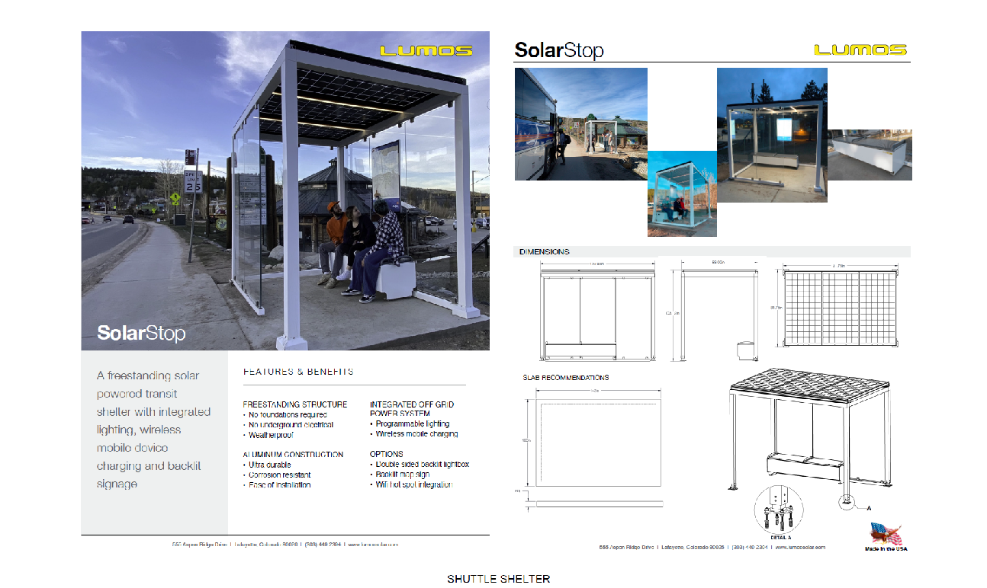
GOLD LOT: PROJECT OVERVIEW
(PRE-SCHEMATIC)

Slide 10
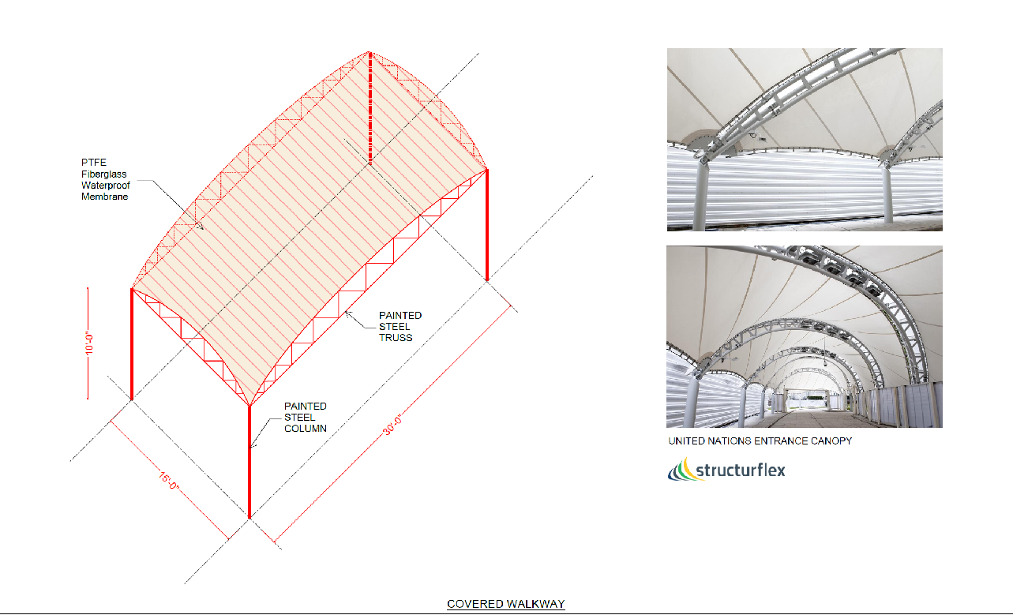
GOLD LOT: PROJECT OVERVIEW
(PRE-SCHEMATIC)

Slide 11
SCOPE OF SERVICES

Slide 12
GOLD LOT: SCOPE OF SERVICES
(PARTIAL LIST)
Design & Design Mgmt.
Construction & Construction Mgmt.
Subcontracting Plan & Reporting (Both Design and Construction)
Safety Plan & Mgmt.
Schedule & Cost Mgmt.
Sustainability Plan & Mgmt.
Quality Plan & Control
Airfield & Project Security Plan & Mgmt.
Community Impact Plan and Implementation
Adherence to Airport & EPM Program Governance Plan
Coordination with Airport & FAA

Slide 13
SCOPE OF WORK

Slide 14
GOLD LOT: SCOPE OF WORK
  Wildlife fence (FAA)
  Pavement assessment, repair, and marking removal
  Covered walkway routed from parking area to existing Headhouse
  (Terminal) Baggage Claim level
  Parking lot access control and revenue collection systems integrated
  with existing airport systems

Slide 15
GOLD LOT: SCOPE OF WORK
  Parking lot and walkway electrical and mechanical infrastructure
  Shuttle bus shelters
  Security elements: call boxes and blue light systems
  Parking lot striping
  Parking area roadways, travel lanes, curbing and walkways
  Vehicle access and egress connecting with public roadways

Slide 16
GOLD LOT: SCOPE OF WORK
  Parking area & walkway lighting
  IT infrastructure and fiber optics, as required to support other systems
  such as security and revenue collection
  Wayfinding and directional signage public and private
  ODOT Coordination
  Landscaping and drainage

Slide 17
GOLD LOT: SCOPE OF WORK
(Key Requirements)
  Wildlife fence separating AOA from parking area
  Must be constructed first and requires extensive coordination in
  both design and construction
  Requires FAA approval of design and installation plan (Assist 7460 Permit submittal)
  Lighting
  Supplement with new lighting to meet code

Slide 18
ALTERNATES

Slide 19
GOLD LOT: SCOPE OF WORK
Alternates
  Route covered walkway to Departures Level walkway
  Route fence underneath east edge of concourse D structure
  Secure building “Fingers,” if this option is taken
  (SIDA security badging access may be required)
  Provide “Pay-on-Foot” revenue collection stations at shelters

Slide 20
SCHEDULE

Slide 21
GOLD LOT APPROXIMATE SCHEDULE
Register in OpenGov Advertise | NOW 06/04/2025
Pre-bid | 06/17/2025
Questions Due | 06/24/2025
Answers Published | 07/01/2025
Qualifications Proposal Due | 07/15/2025
NTP (Estimated) | 10/01/2025
Construction Begin | 04/01/2026
Latest Construction Complete | 12/31/2026

Slide 22
Q & A
Gold Lot Redevelopment

Slide 23

THANK YOU FOR YOUR SUPPORT IN OUR PROGRAM
For more information, please visit itsaclevolution.com

Slide 24

The renderings, illustrations, and visual materials presented herein are intended for conceptual and illustrative purposes only. They do not represent the final design, specifications, or materials and are subject to change without notice. Final outcomes may vary based on design development, regulatory approvals, and other considerations.
This presentation is confidential and intended solely for internal review. It is not for public distribution or external sharing without prior written consent.

