Slide 2
PRESENTERS
DANNY CRUMLEY
Program Controls Manager
PASLAY GROUP
ERIN MCGUINESS, P.E.
Teaming Partner
MCGUINESS UNLIMITED

Slide 3
01
02
03
INTRODUCTION
PROJECT OVERVIEW
PROJECT ELEMENTS
04
05
06
SCOPE OF SERVICES
QUALIFICATIONS
SCHEDULE

Slide 4
PROJECT OVERVIEW

Slide 5
BASIC SCOPE PARAMETERS
The Work
Terminal and landside development
$1.6 billion
Eight years – Now to 2033
Roles
Airport Leadership / EPM / Stakeholders direct the work
Executive Management Team leads the work: drives the program
PM/CM executes the work
TMDP Leadership
Airport Leadership: Bryant Francis, Airport Director and Dennis Kramer, Assistant Director (DPC)
Executive Program Manager: Terry Cassidy (Paslay)
Executive Management Team: Design, Construction, Program Controls, ORAT (Paslay)
PM/CM Team: (2 year contract w/ multiple 3 year renewals)

Slide 6
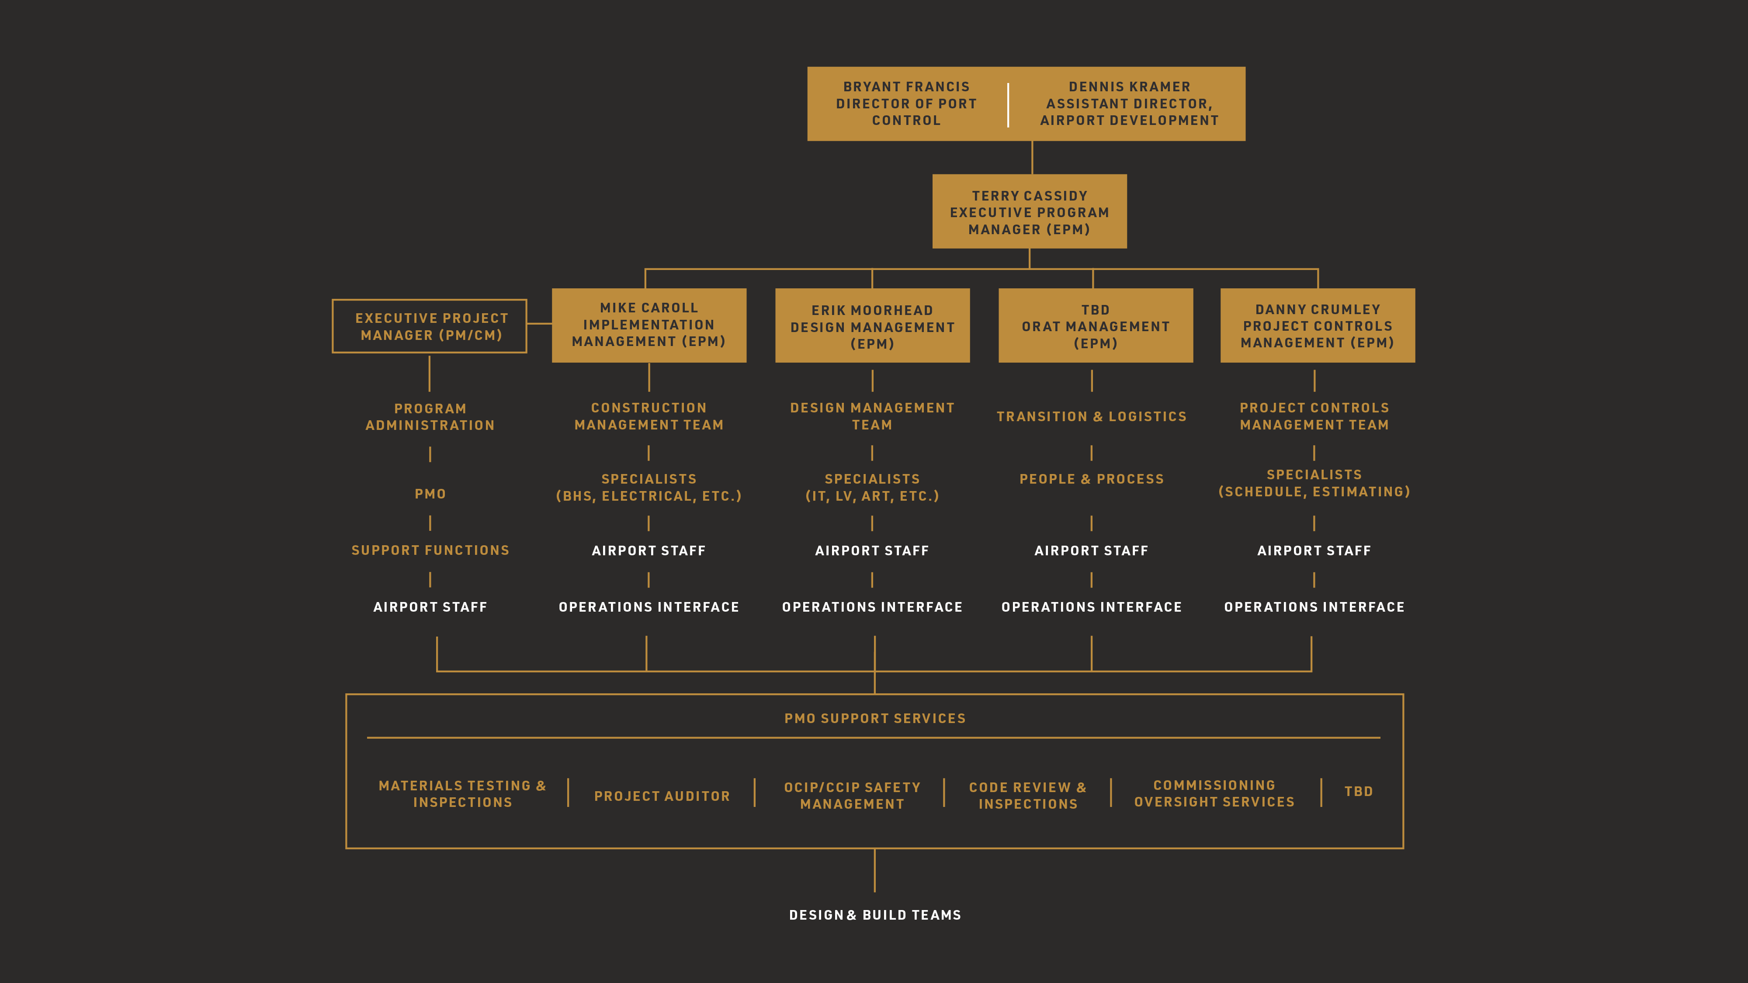

Slide 7
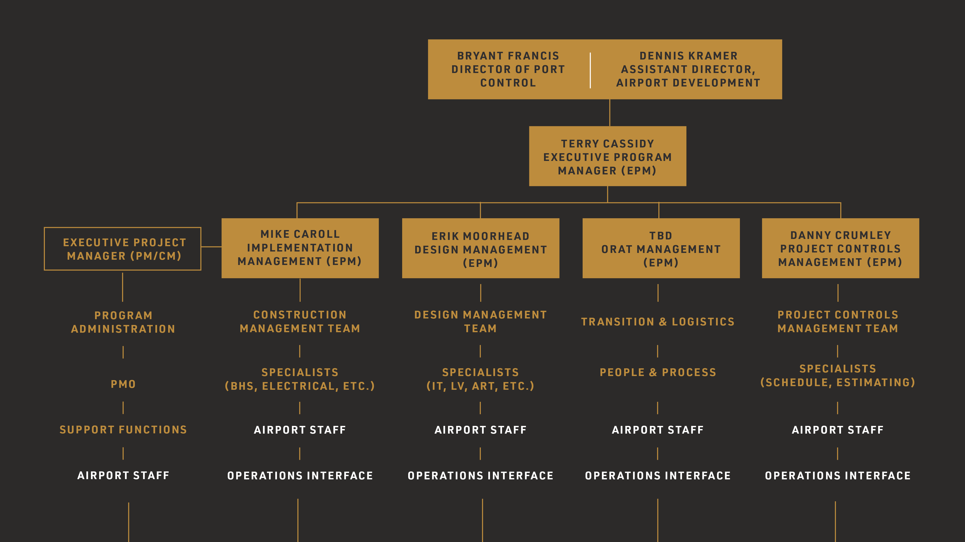

Slide 8
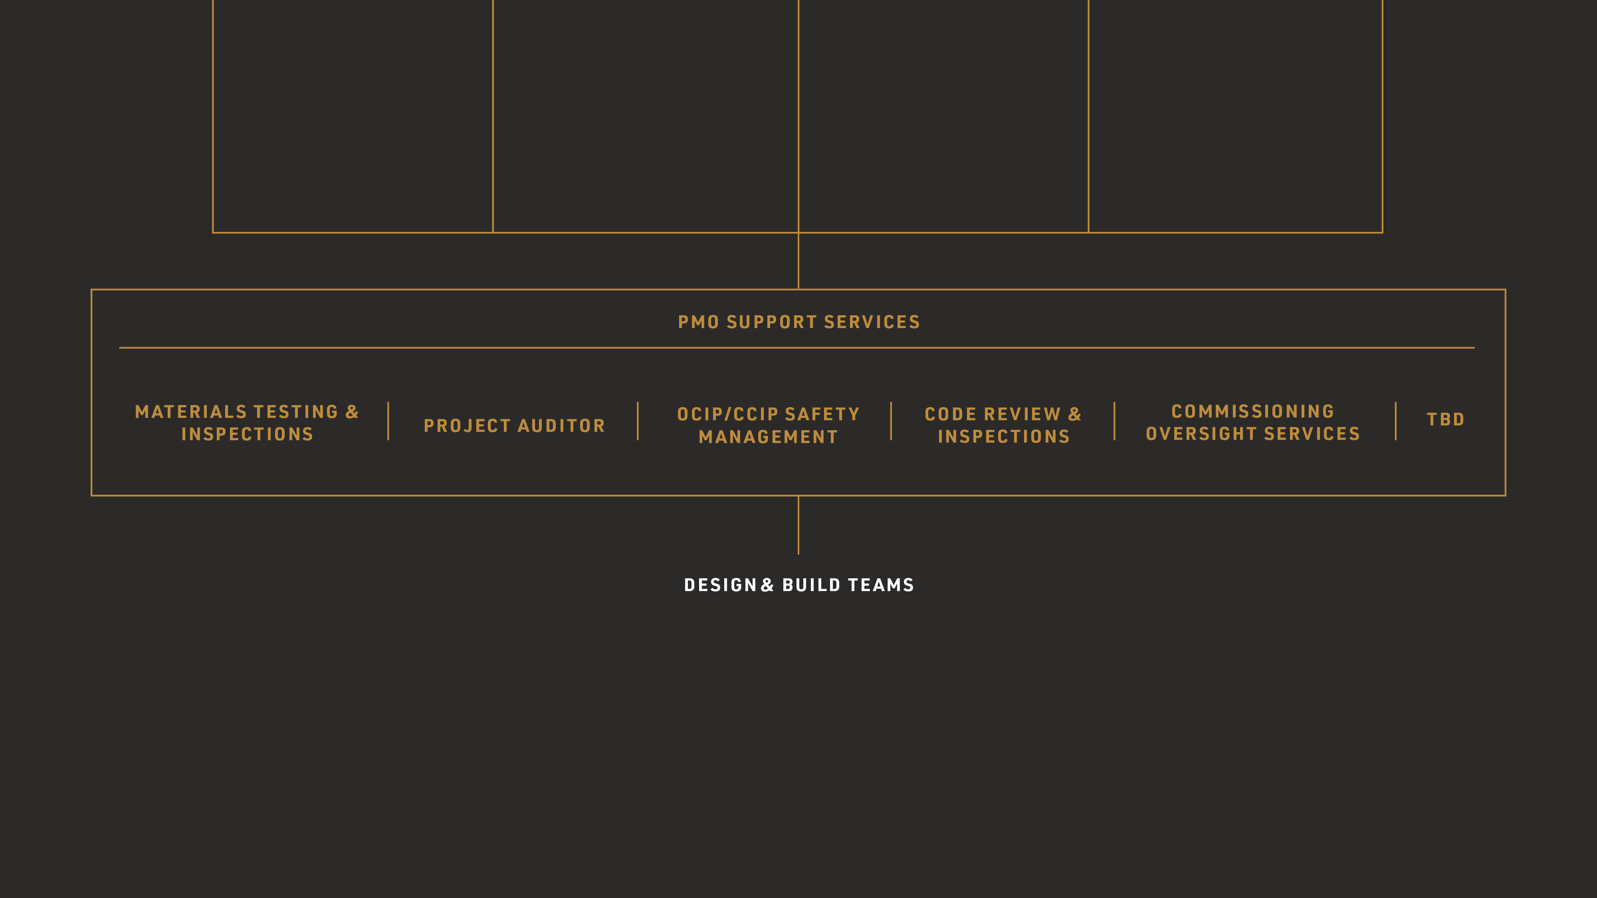

Slide 9
PROGRAM ELEMENTS

Slide 10
PROGRAM ELEMENTS
Initial program is focused on parking due to customer demands.
New Surface Parking Area – Gold Lot – 1400+ spaces
New RTA Platform Redevelopment and Underground Pedestrian Walkway
New Parking Garage: 6000+ spaces
New Ground Transportation Center
Additional Enabling Projects
$476 million and five years of construction
Future program
Head House: design start 2026, construction start late 2029
Roadway and Demolition projects

Slide 11

PROGRAM ELEMENTS

Slide 12
SCOPE OF SERVICES

Slide 13
SCOPE OF SERVICES
Design management: Gold Lot, Parking Garage and Terminal Development (Head House)
Construction Management: inspectors, risk management & safety, QA Testing & Inspections
Cost Management: cost estimating, budget tracking, change management/negotiation
Schedule Management: scheduling, resource allocation, schedule tracking
Operational Readiness Activation and Transition (ORAT): delivery of seamless transition from construction to facility operation through development of policies, procedures and training
Other support services necessary for successful program delivery

Slide 14
QUALIFICATION

Slide 15
QUALIFICATION
Company
Fifteen (15) continuous years of PM/CM experience and the last ten (10) years providing
PM/CM airport specific services.
Previous experience in providing PM/CM services on a Large-Scale Modernization and/or
Development Program for other airports.
Be authorized to conduct business in the State of Ohio and the City of Cleveland

Slide 16
QUALIFICATION
Staff - Key Staff positions
Program Leadership-Executive Project Manager
Design Management: Assistant Design Manager, Garage/Landside Lead, Terminal Lead,
Passenger Experience Lead
Implementation: Project Manager(s) - Garage/Landside/Infrastructure Lead, Ramp/Airside Lead, Construction Quality Assurance (QA) Manager, Baggage Handling System Lead, Low Voltage Lead
Project Controls: PMIS Administrator, Lead Scheduling Analyst and Lead Project Estimator
Operational Readiness and Activation Transition (ORAT) Area: People and Process Lead,
Transition and Logistics Lead

Slide 17
SCHEDULE

Slide 18

PROCUREMENT APPROXIMATE DATES
Register in Open Gov, subscribe and hit follow:
June 23, 2025 RFQ issued
June 30, 2025 Pre-Qualification Conference
August 1, 2025 Proposals submission deadline
Week of August 11, 2025 Interviews, if necessary
August 29, 2025 Anticipated notice of selection
October 1, 2025 Anticipated Contract NTP pending City approval process

Slide 19

PROGRAM APPROXIMATE DATES
GOLD LOT: CONCOURSE D SURFACE PARKING & WALKWAY
DESIGN & BUILD
NEW PARKING
GARAGE
RTA STATION REDEVELOPMENT
(NEW PLATFORM & PEDESTRIAN TUNNEL)
NEW GROUND
TRANSPORTATION
CENTER
DESIGN
NEW TERMINAL
HEADHOUSE
BUILD NEW
TERMINAL
HEADHOUSE

Slide 20
Q & A

Slide 21

THANK YOU FOR YOUR SUPPORT IN OUR PROGRAM
For more information, please visit itsaclevolution.com

Slide 22

The renderings, illustrations, and visual materials presented herein are intended for conceptual and illustrative purposes only. They do not represent the final design, specifications, or materials and are subject to change without notice. Final outcomes may vary based on design development, regulatory approvals, and other considerations.
This presentation is confidential and intended solely for internal review. It is not for public distribution or external sharing without prior written consent.

